Slide 1
Kubernetes Project from: Jingjing Tan student ID: 19548

Slide 2
Table of Contents
Introduction
Design
Implementation
Test
Conclusion

Slide 3
Introduction
Techniques this project used
Pods: there are 2 pods to run applications, one is student records, the other one is bookstore
Services
MongoDB: store data
Ingress: expose applications in one domain
ConfigMaps: store MongoDB service address, in case not to build docker image when mongodb is down

Slide 4
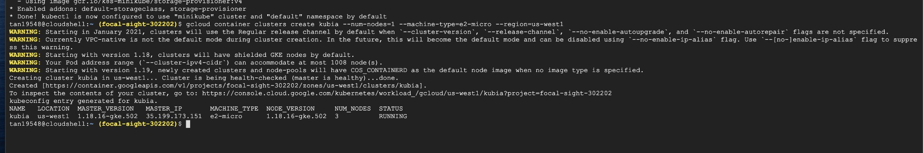
Design step1: create mongoDB using Persistent Volume
gcloud container clusters create kubia --num-nodes=1 --machine-type=e2-micro--region=us-west1

Slide 5
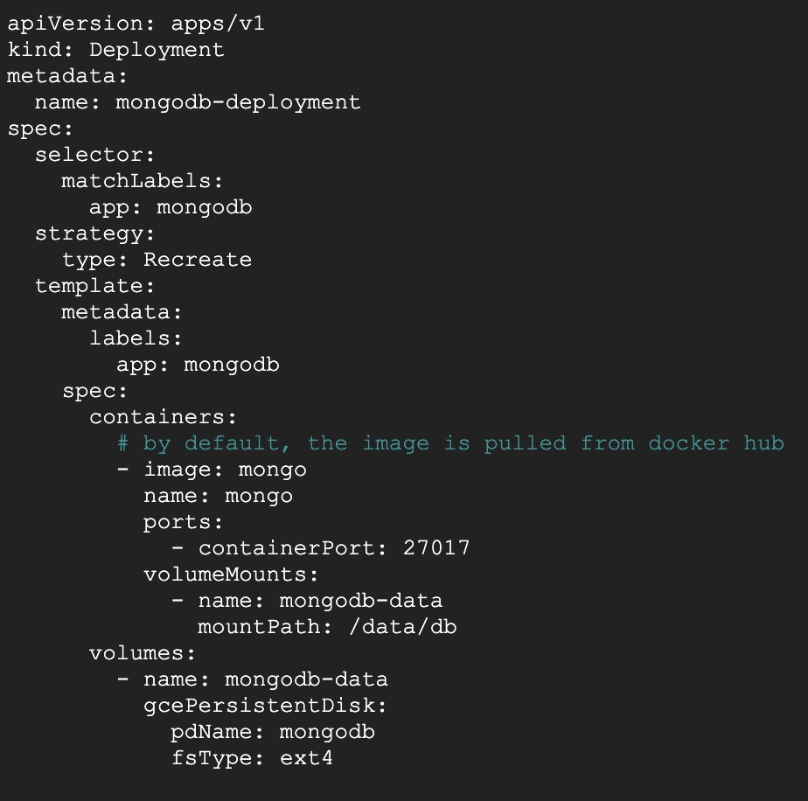
Design step1: create mongoDB using Persistent Volume
w create a mongodb deployment
kubectl apply -f mongodb-deployment.yaml

Slide 6
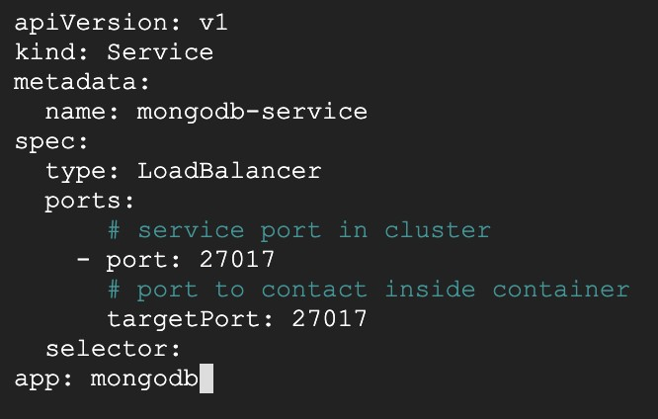
Design step1: create mongoDB using Persistent Volume
Create a service for the mongoDB to make it be accessed outside
2.
2.
2.
Apply yaml
Apply yaml
Apply yaml
Apply this yaml

Slide 7
Design step1: create mongoDB using Persistent Volume
apply mongodb-service
check pods
check services
run in bash

Slide 8
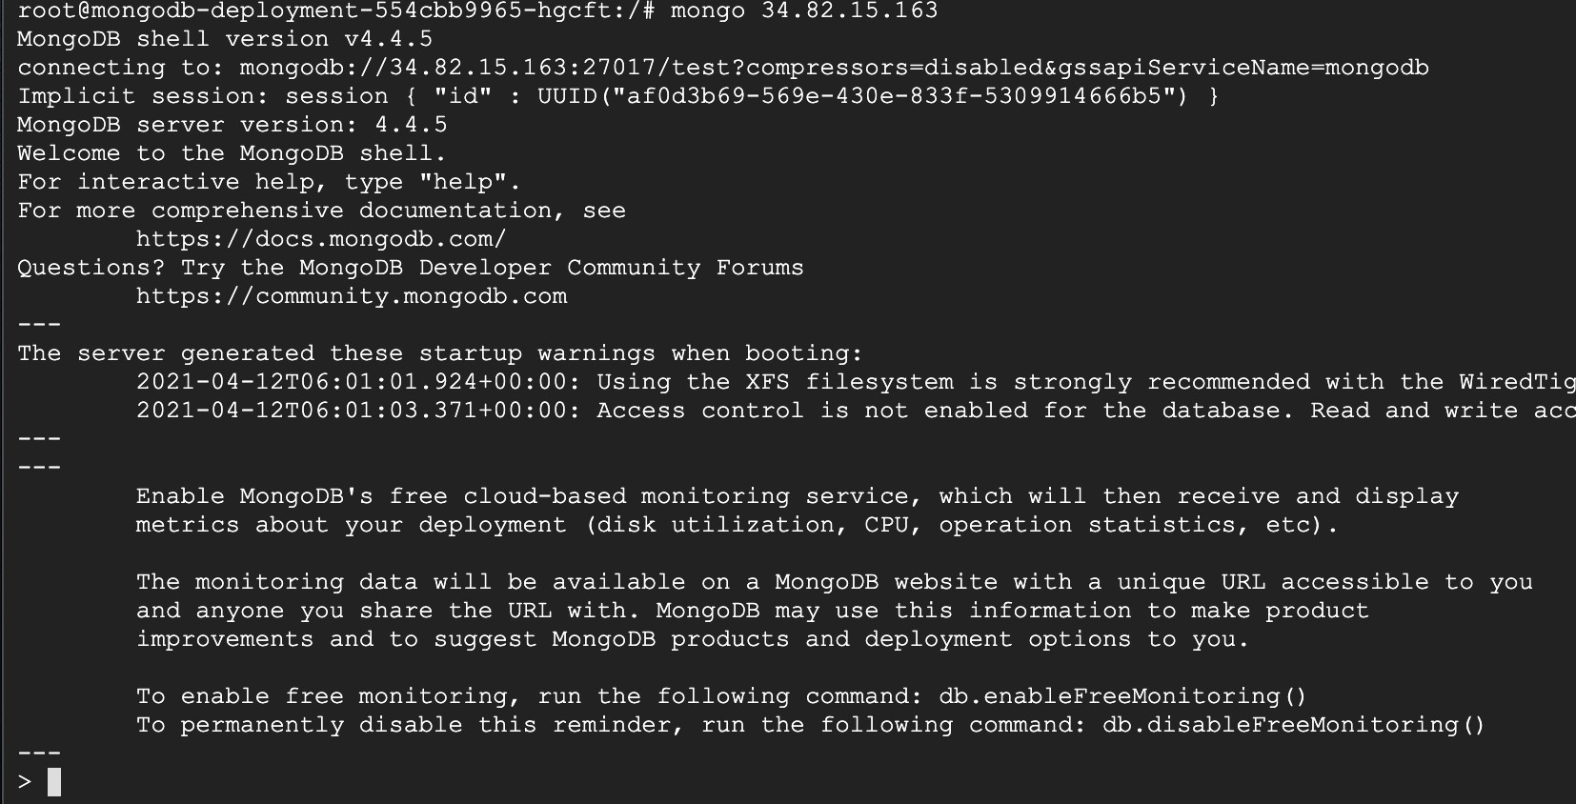
Design step1: create mongoDB using Persistent Volume
check if mongoDB is functioning for connections using the External-IP

Slide 9
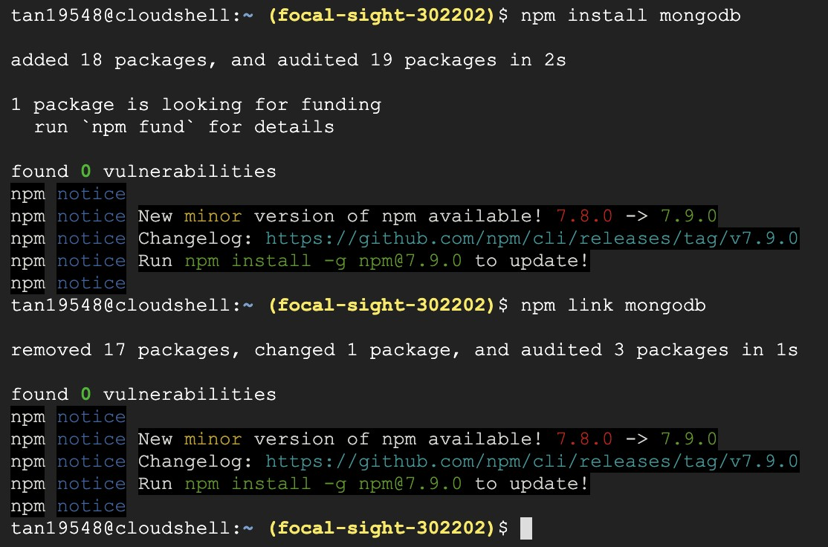
Design step1: create mongoDB using Persistent Volume
install mongodb-service

Slide 10
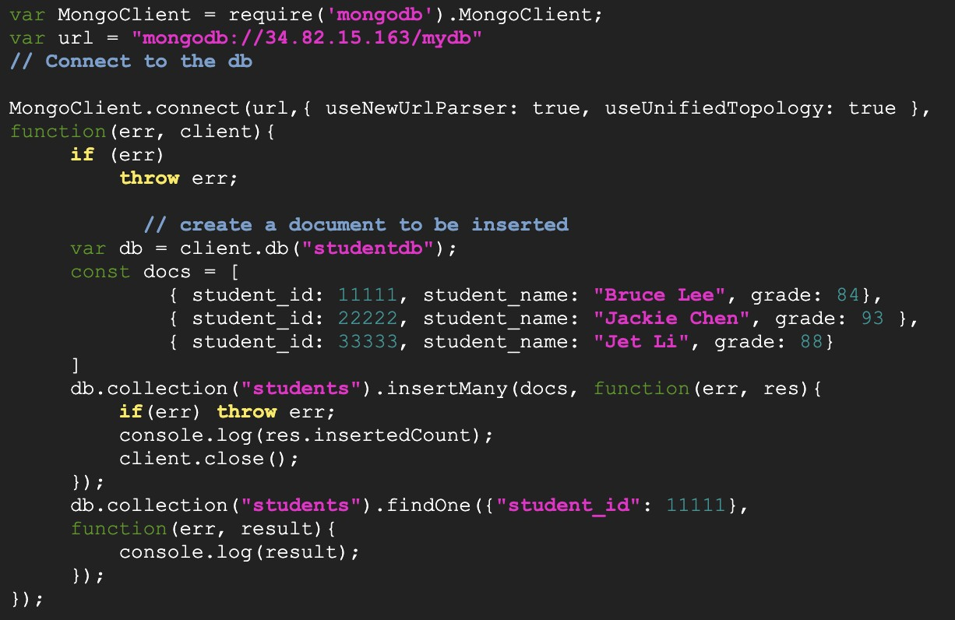
Design step1: create mongoDB using Persistent Volume
create mongodb.js

Slide 11
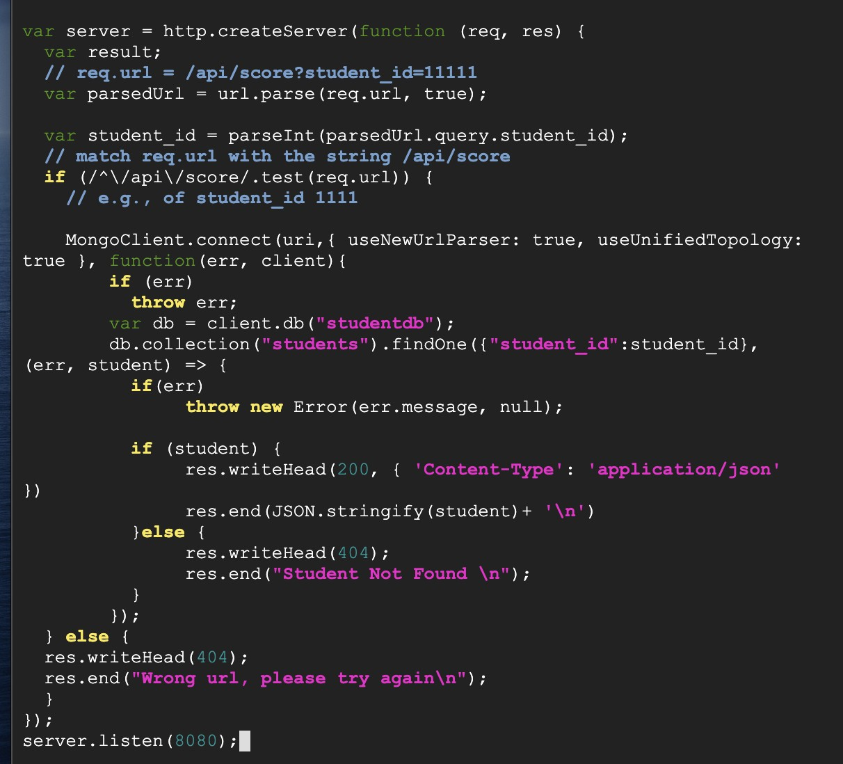
Design step1: create mongoDB using Persistent Volume
Create studentServer.js

Slide 12
Design step2: modify student server to get records from mongoDB
create studentServce

Slide 13
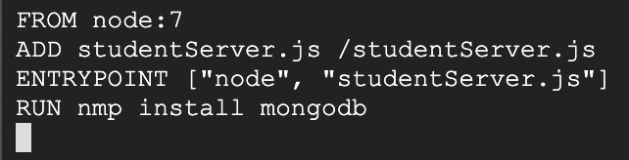
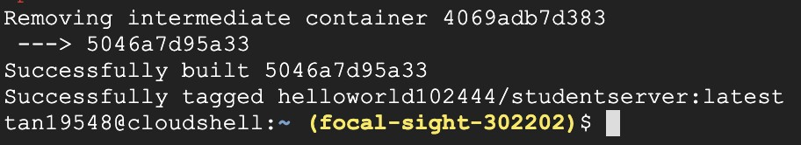
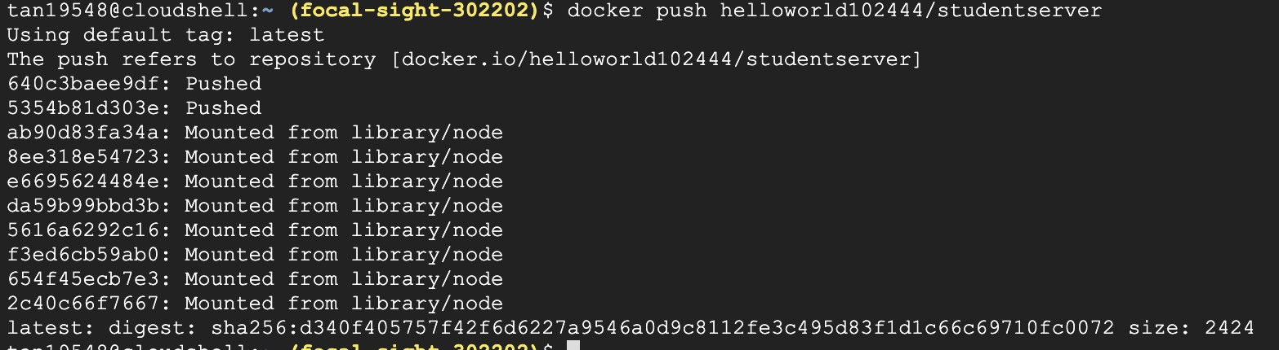
Design step2: modify student server to get records from mongoDB
Create docker file
Build docker
Docker push

Slide 14
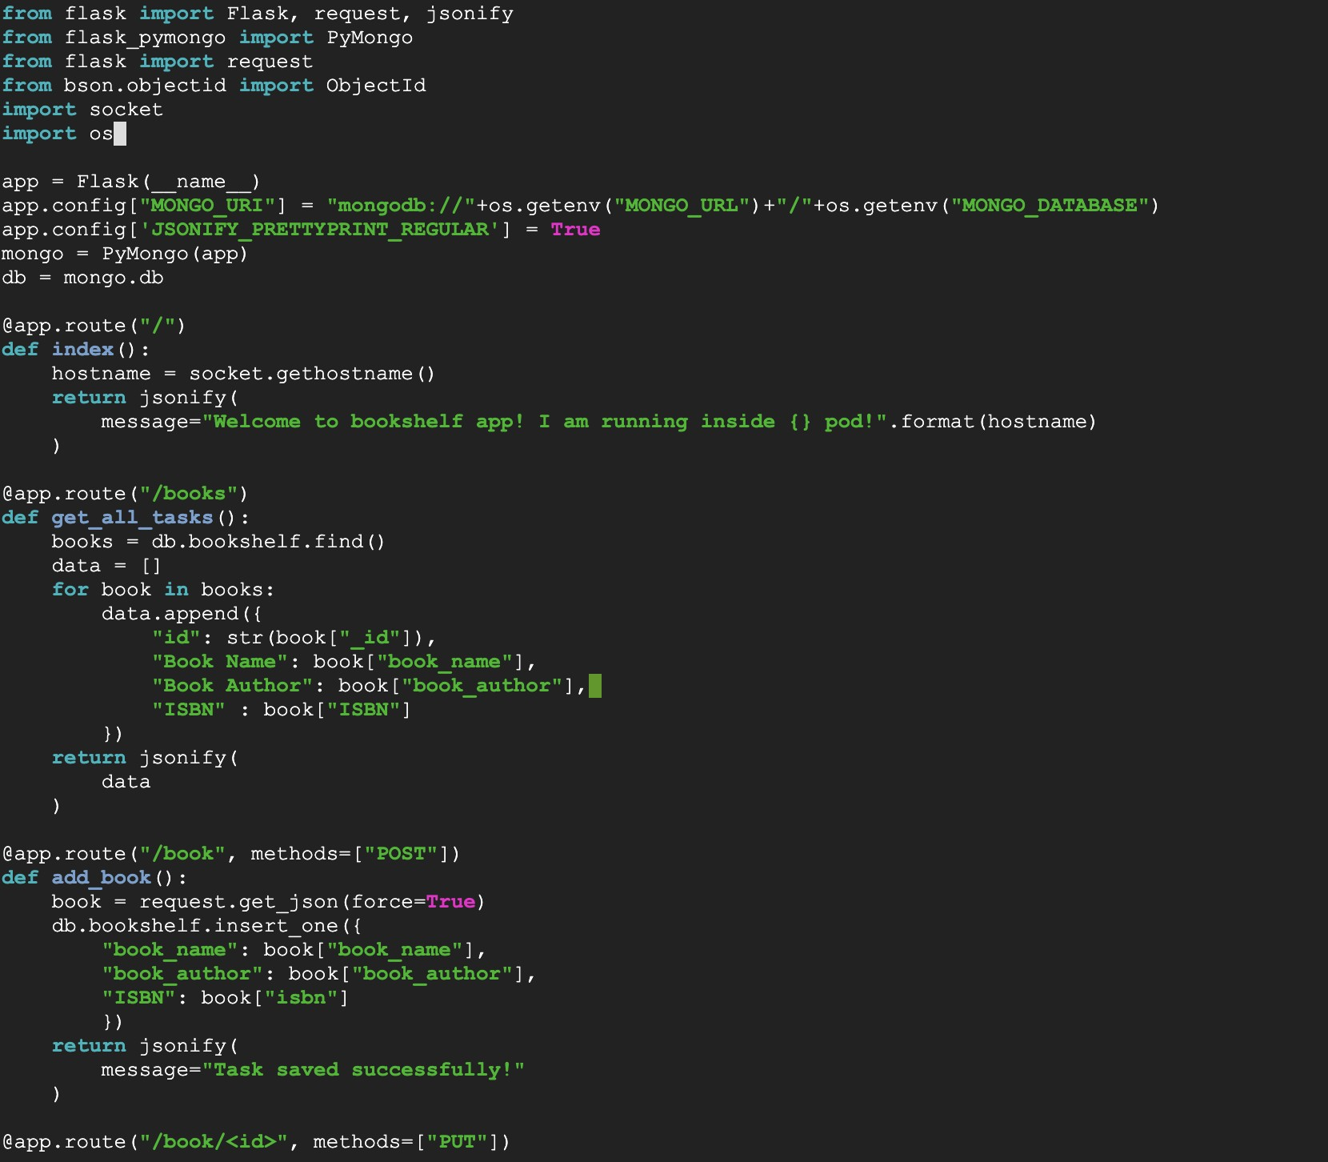
Design step2: modify student server to get records from mongoDB
create bookshelf.py

Slide 15
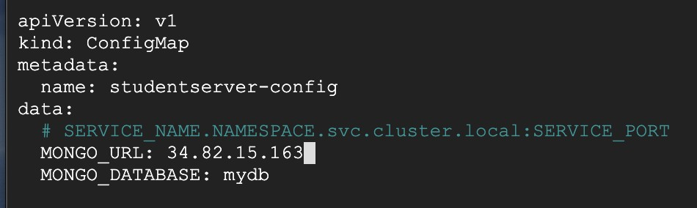
Design step2: modify student server to get records from mongoDB
create studentserver-configmap.yaml

Slide 16
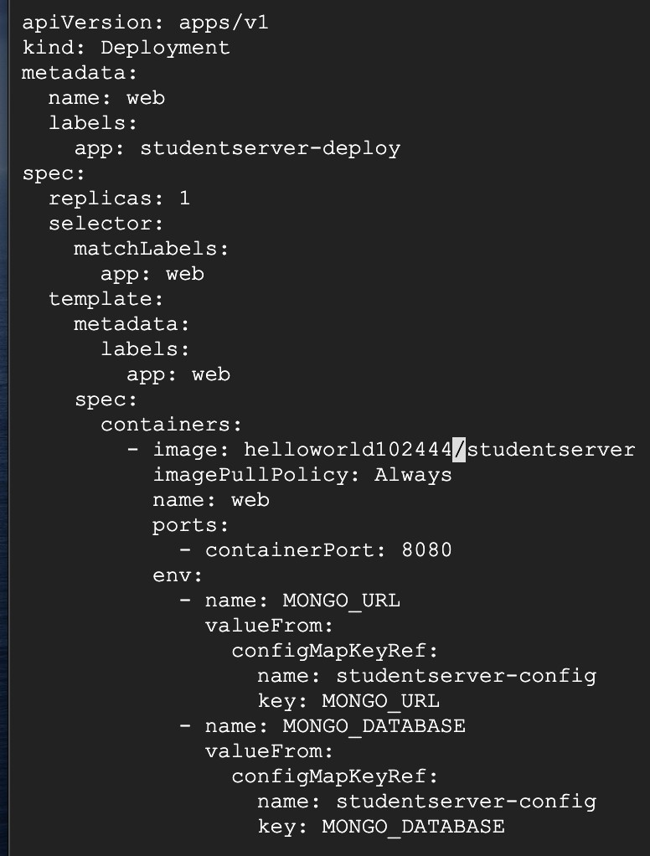
Design step2: modify student server to get records from mongoDB
studentserver-deployment.yaml

Slide 17
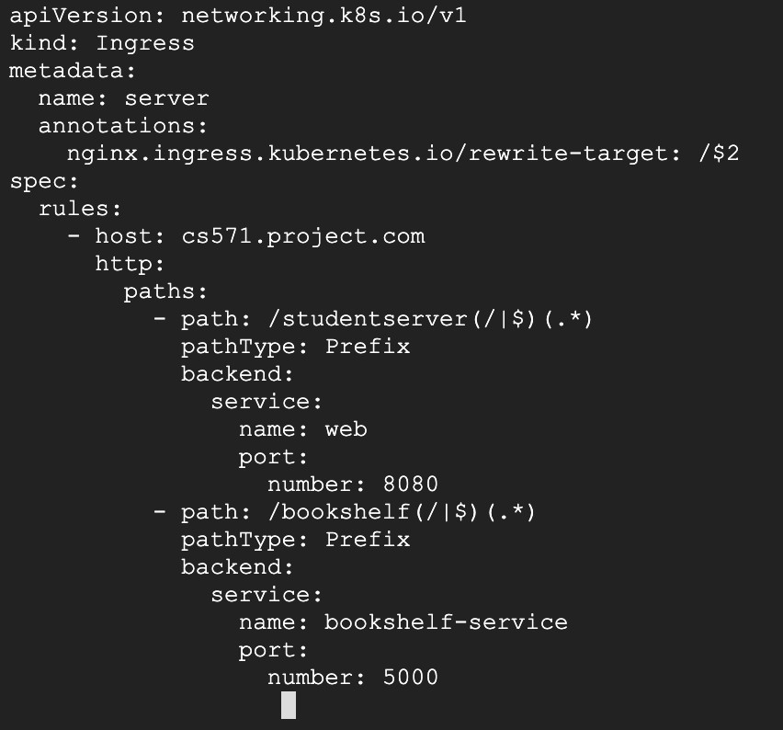
Ingress
create studentserver-servermongoIngress.yaml

Slide 18
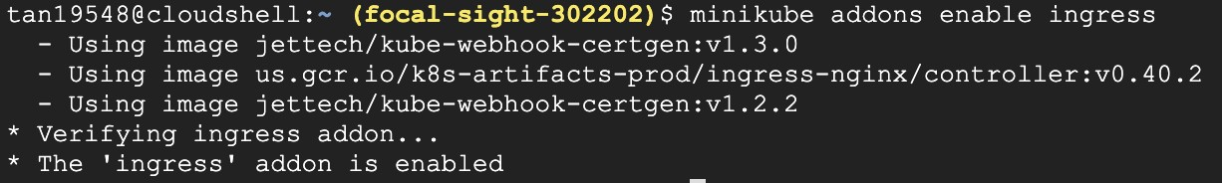
Want big impact? Use big image.
Ingress
Minikube enable ingress

Slide 19
Want big impact? Use big image.
Ingress
Create studentservermongoIngress.yaml

Slide 20
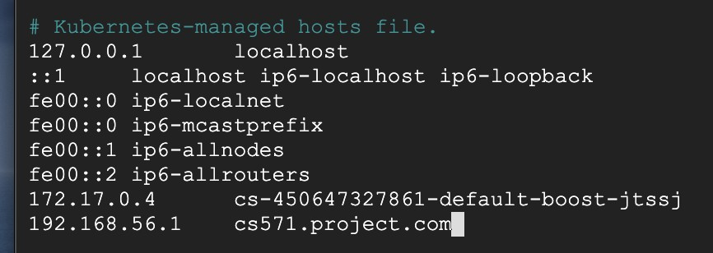
Want big impact? Use big image.
Test:
Add hosts

Slide 21
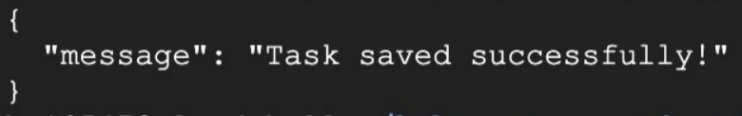
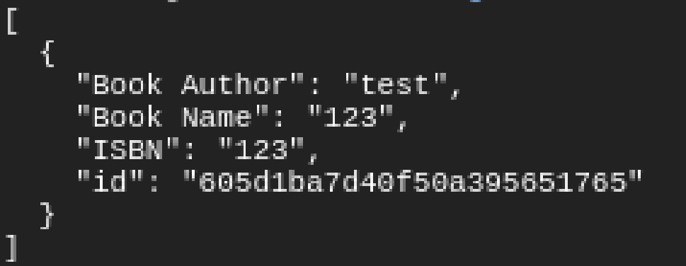
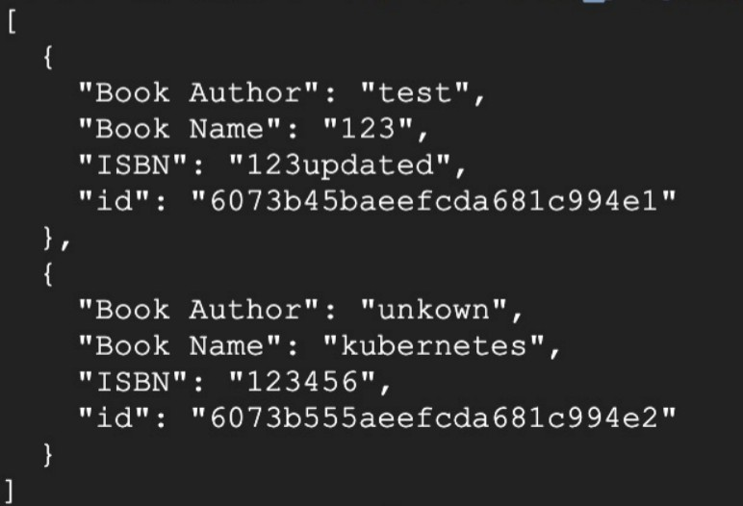
Want big impact? Use big image.
Test:
Curl
List book
Add book

Slide 22
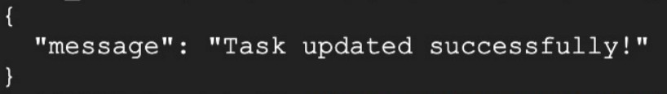
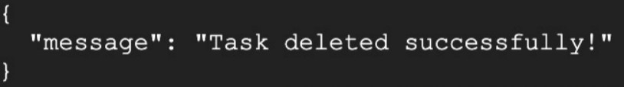
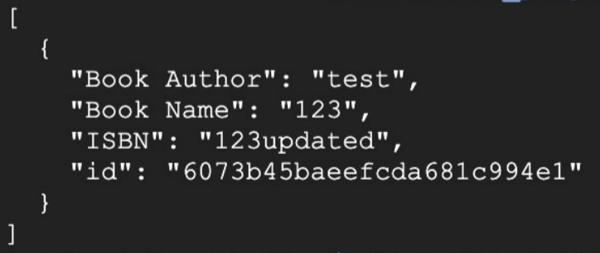
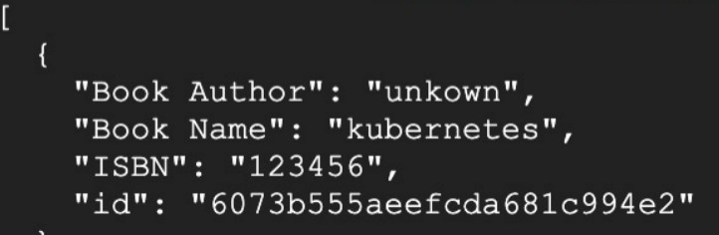
Want big impact? Use big image.
Test:
update book
delete book

Slide 23
Reference:
https://npu85.npu.edu/~henry/npu/classes/kubernetes_in_action/configmap/slide/exercise_configmap.html#sp
https://npu85.npu.edu/~henry/npu/classes/cloud_computing/mongodb/slide/index_slide.html
https://npu85.npu.edu/~henry/npu/classes/flask_web_development/api/slide/index_slide.html

